Slide 1
NTTD Partner Spotlight: Colorado DOT & Adaptability Best Practices
Kevin MacVittie • Technical Training Programs Manager
12/3/2020

Slide 2
Overview
Mindset Change
Fixed vs Growth Mindset
Agile Planning - First 4 Months
Close Communication Gaps
Demonstrate “Ease of Use”
Deliberate Group Engagement
Shared Roles & Responsibilities

Slide 3
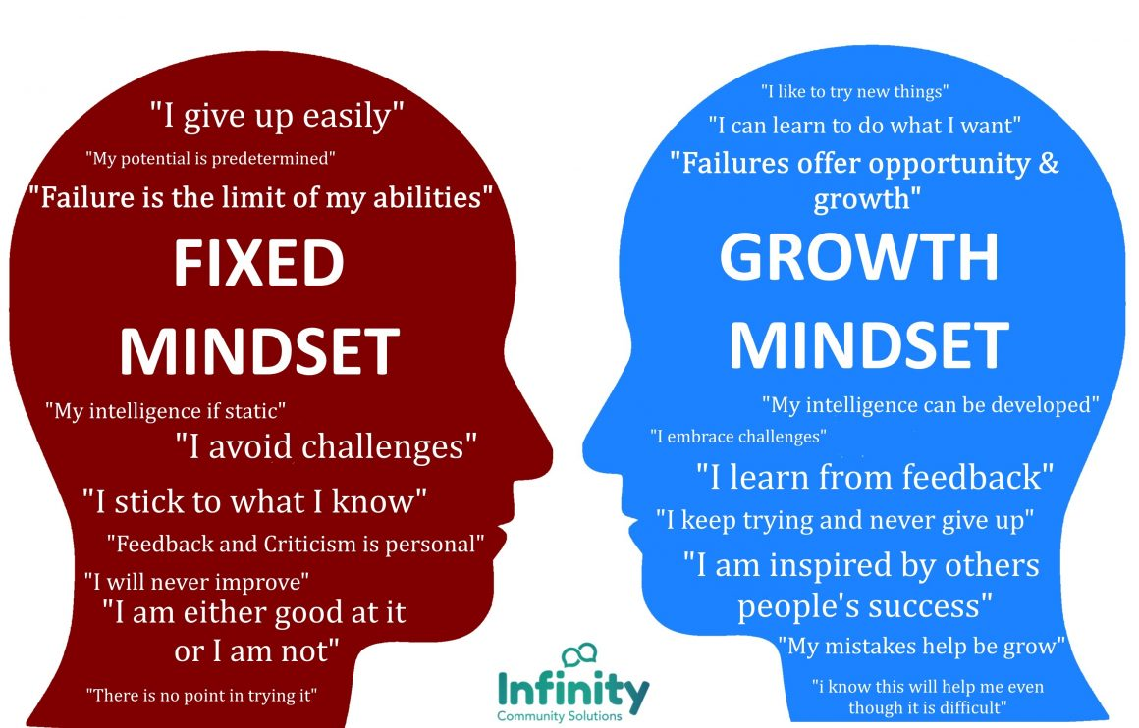
Mindset Change
Plan for behavior shift
Solicit buy-in
Training Team
Stakeholders
2 Teams @ CDOT
1 Cohesive Approach

Slide 4
Mindset Change
Eliminate barriers for audience
Project Consistency
Tools & Resources
Communication
Adaptive to Feedback

Slide 5
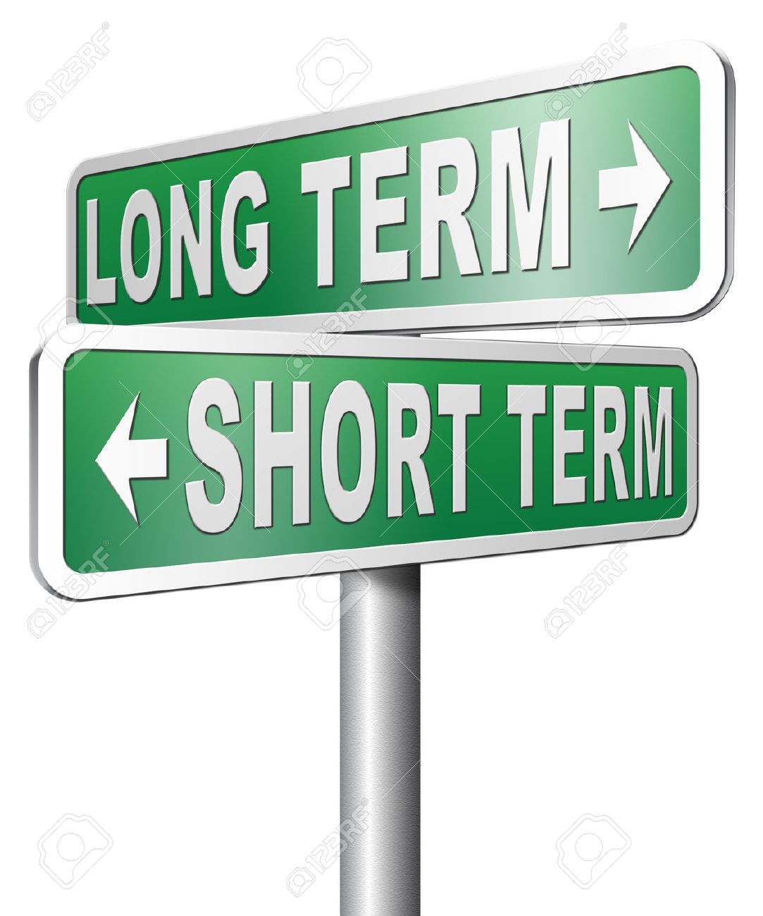
Short Term Plan
Prioritize Actual Needs
Academy - 11 Programs
Redesigned 2 (to start)
Focus on Early/Big Wins
New Hire (training pay)
Winter Ops Training

Slide 6
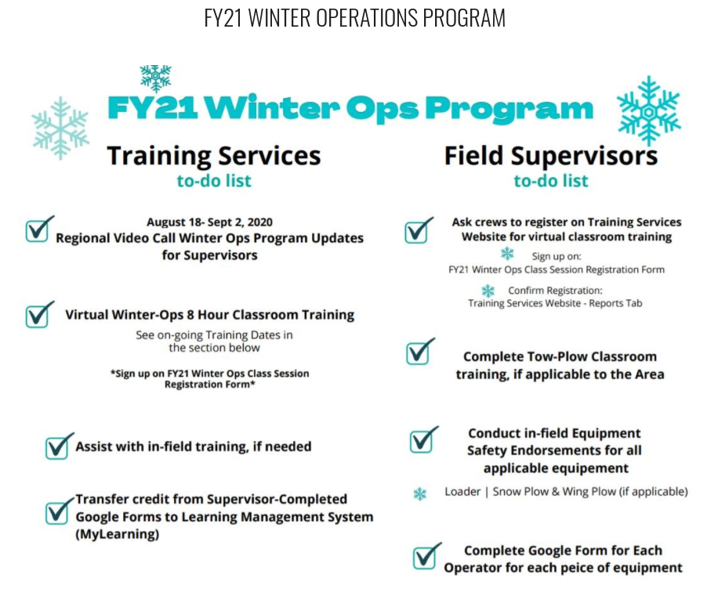
Close Communication Gap
Leverage Website
Leverage Do-it-yourself
To-Do List for Mgrs
Registration
Reporting

Slide 7
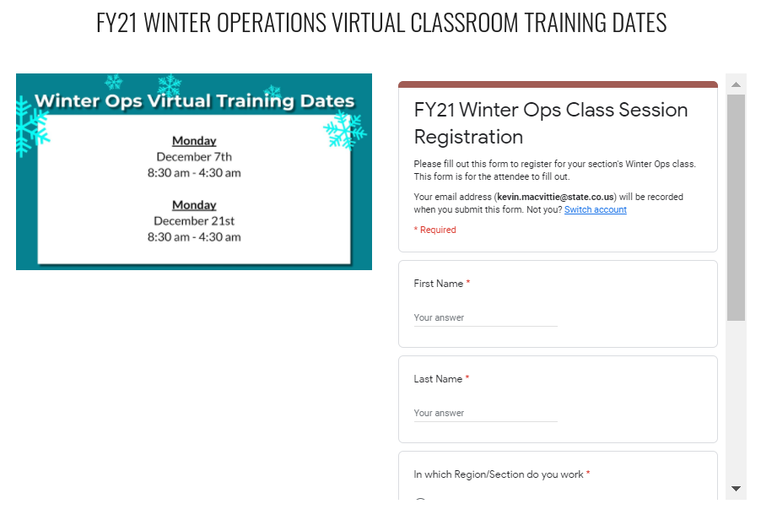
Close Communication Gap
Leverage Website
Leverage Do-it-yourself
To-Do List for Mgrs
Registration
Reporting

Slide 8
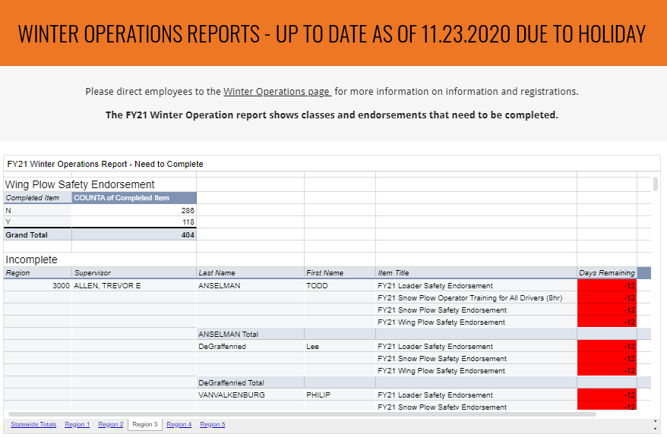
Close Communication Gap
Leverage Website
Leverage Do-it-yourself
To-Do List for Mgrs
Registration
Reporting

Slide 9
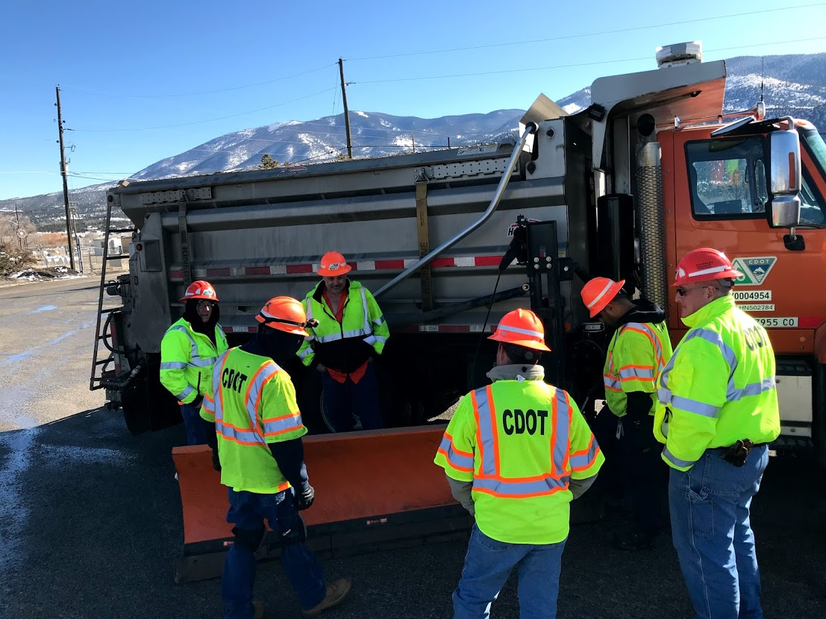
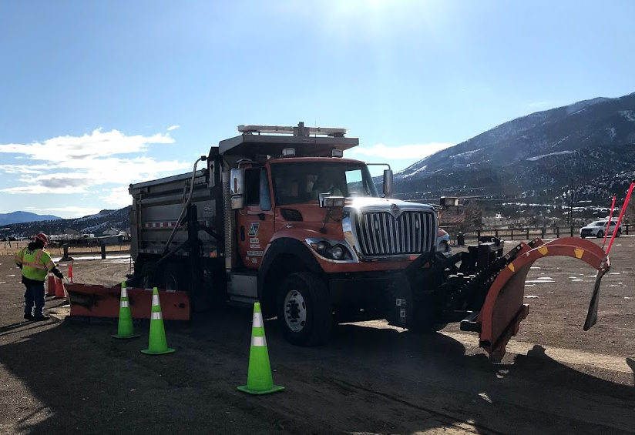
Deliberate Engagement
Supervisor Attendance
Targeted Q&A
Presenter Roles
Moderator Roles
Plan & Process for Hands-on at local level

Slide 10
CDOT Training Services
Developing a Growth Mindset (YouTube)
Design Thinking Process
Stanford - Design Thinking
Stanford - Design Thinking Resources

Slide 11
Questions?

