Slide 1
The mission of the Indiana Construction Roundtable Foundation is to encourage, empower and inform individuals to pursue careers within the construction industry.
Notes:
Chris to Present
Our mission’s importance
Our group was formed in 2015 out of the ICR. The ICR was an organization that is focused on the construction consumers and is labor neutral
In Indiana we were struggling to find people who could fill the demand and we were facing significant shortages.
We successfully worked with and partnered with our state government to launch the ICR Foundation
We’ve currently got two programs that are helping us to deliver on this important mission

Slide 2
training objectives
Focus on people instead of industry silos
Addressing the skills gap with training
Added focus on recruitment of minorities and women
A focus on poverty
Helping connect our veterans to opportunity
Helping previously incarcerated people
Notes:
Chris to PresentThe second program that our association developed was intended to address the skills gap that is keeping people from pursuing a career in construction.
If a person doesn’t have experience using tools, they aren’t empowered to apply for a construction job
So, BY Training is a program that is a feeder system of trained and vetted people
Our program utilizes NCCER Core Curriculum
NCCER Core Curriculum teaches basic concepts that are needed to succeed on the job on day number 1
The program is free to applicants and is an 80 hour long program.
The education requirement for this program is an 8th grade equivalency in reading and math
The program is people focused and is aimed at doing good for our communities.
We are focused on the recruitment of minorities who are under-represented in our industry and are disproportionately affected by poverty and incarceration. As well as a focused on women, who make up the majority of our population and only 9% of our over-all industry
We are partnering with veterans groups to credential veterans based on the training they received in the military through NCCER’s Hardhat Heroes program
And, we are previously convicted felons to get them the training they need to succeed in a career in construction. This will drop the recidivism rates of people from roughly 39% to 5%
AND most importantly we are working with employers in each of the sectors of the construction industry to get our people placed into jobs. We have strong employer commitments to our program and anticipate placing 100% of our graduates into jobs in the industry.

Slide 3
by roads overview
Specific focus on highway sector
Taught by instructor experienced in highway construction
Class visits and hiring event will target employers and labor partners from highway sector
Classes ideally include a visit to a highway jobsite
Notes:
Explain the program
Mention that NCCER has over 14MM training module completions and has worked with nearly 7MM students and instructors

Slide 4
NCCER overview
Work with over 4,000 training providers across the United States
Curriculum reviewed by subject matter experts
Federally recognized credentials
Registry System of craftspeople
Stackable curriculum
Training modules with performance verification
Accredited Assessment Centers
Notes:
Explain the program
Mention that NCCER has over 14MM training module completions and has worked with nearly 7MM students and instructors

Slide 5
BY Roads Curriculum
Includes 72 hours of Core Curriculum (same as BY)
OSHA 10 Certificate
Identification of Equipment used in Heavy Highway
Heavy Highway Safety
Work-Zone Safety
Certified Flagger Training
CPR Training
Financial Literacy
Notes:
Explain the program
Mention that NCCER has over 14MM training module completions and has worked with nearly 7MM students and instructors

Slide 6
Trainee Accountability
Scoring system for intangibles
Start with 100 points, and must have 70 points to graduate. Deductions are made as follows:
Unexcused absence (10 points)
Tardiness (5 points)
Discipline (10 points)
Drug Free (31 points)
Notes:
Chris to Present

Slide 7
How are we doing?
2020 Program Performance and Highlights:
82.6% of our students complete the class
77.2% of our students are (still employed) 6 months following class
$20.58/hr graduates median earnings at 6 months following class.
Exceptional Performance Criteria” by the state.
48% of our students have felonies
72% are minorities
15% don’t have a high school diploma or equivalent.
Notes:
Chris to PresentThe second program that our association developed was intended to address the skills gap that is keeping people from pursuing a career in construction.
If a person doesn’t have experience using tools, they aren’t empowered to apply for a construction job
So, BY Training is a program that is a feeder system of trained and vetted people
Our program utilizes NCCER Core Curriculum
NCCER Core Curriculum teaches basic concepts that are needed to succeed on the job on day number 1
The program is free to applicants and is an 80 hour long program.
The education requirement for this program is an 8th grade equivalency in reading and math
The program is people focused and is aimed at doing good for our communities.
We are focused on the recruitment of minorities who are under-represented in our industry and are disproportionately affected by poverty and incarceration. As well as a focused on women, who make up the majority of our population and only 9% of our over-all industry
We are partnering with veterans groups to credential veterans based on the training they received in the military through NCCER’s Hardhat Heroes program
And, we are previously convicted felons to get them the training they need to succeed in a career in construction. This will drop the recidivism rates of people from roughly 39% to 5%
AND most importantly we are working with employers in each of the sectors of the construction industry to get our people placed into jobs. We have strong employer commitments to our program and anticipate placing 100% of our graduates into jobs in the industry.

Slide 8
Workforce Programs
Adult Education – BY Roads
High School – Hamilton Heights
Re-entry – Moving Forward

Slide 9
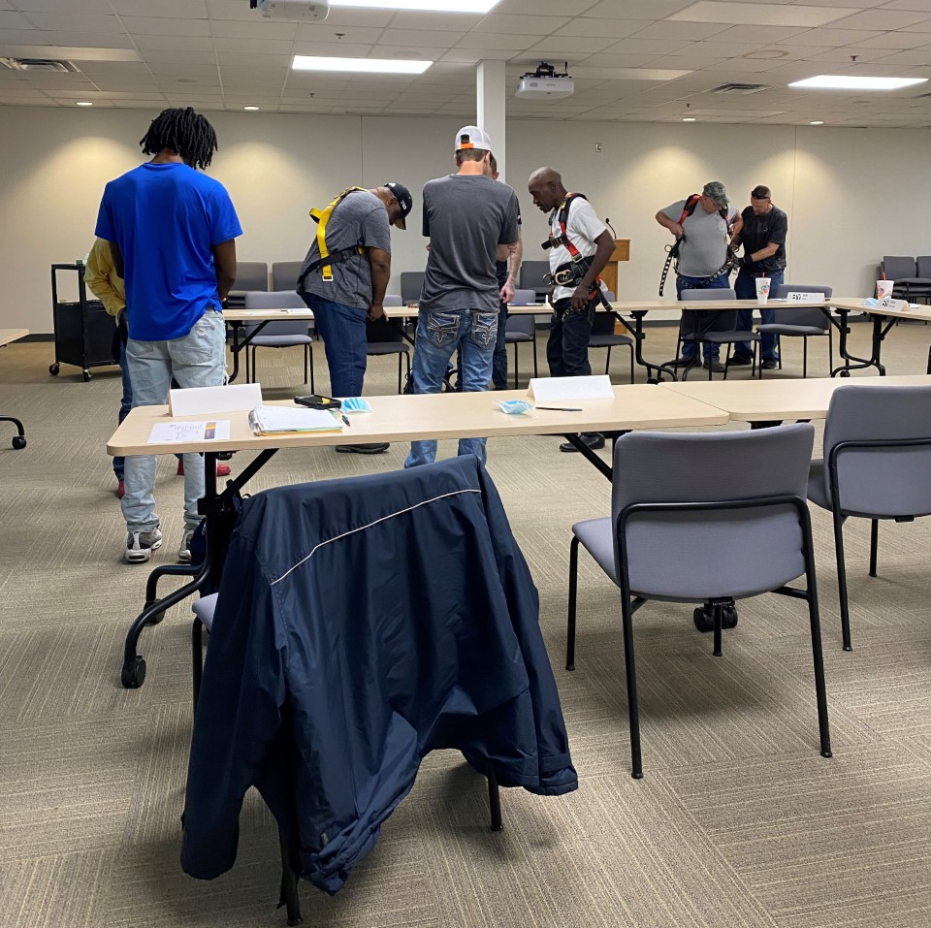
BY Roads
Adult Training

Slide 10
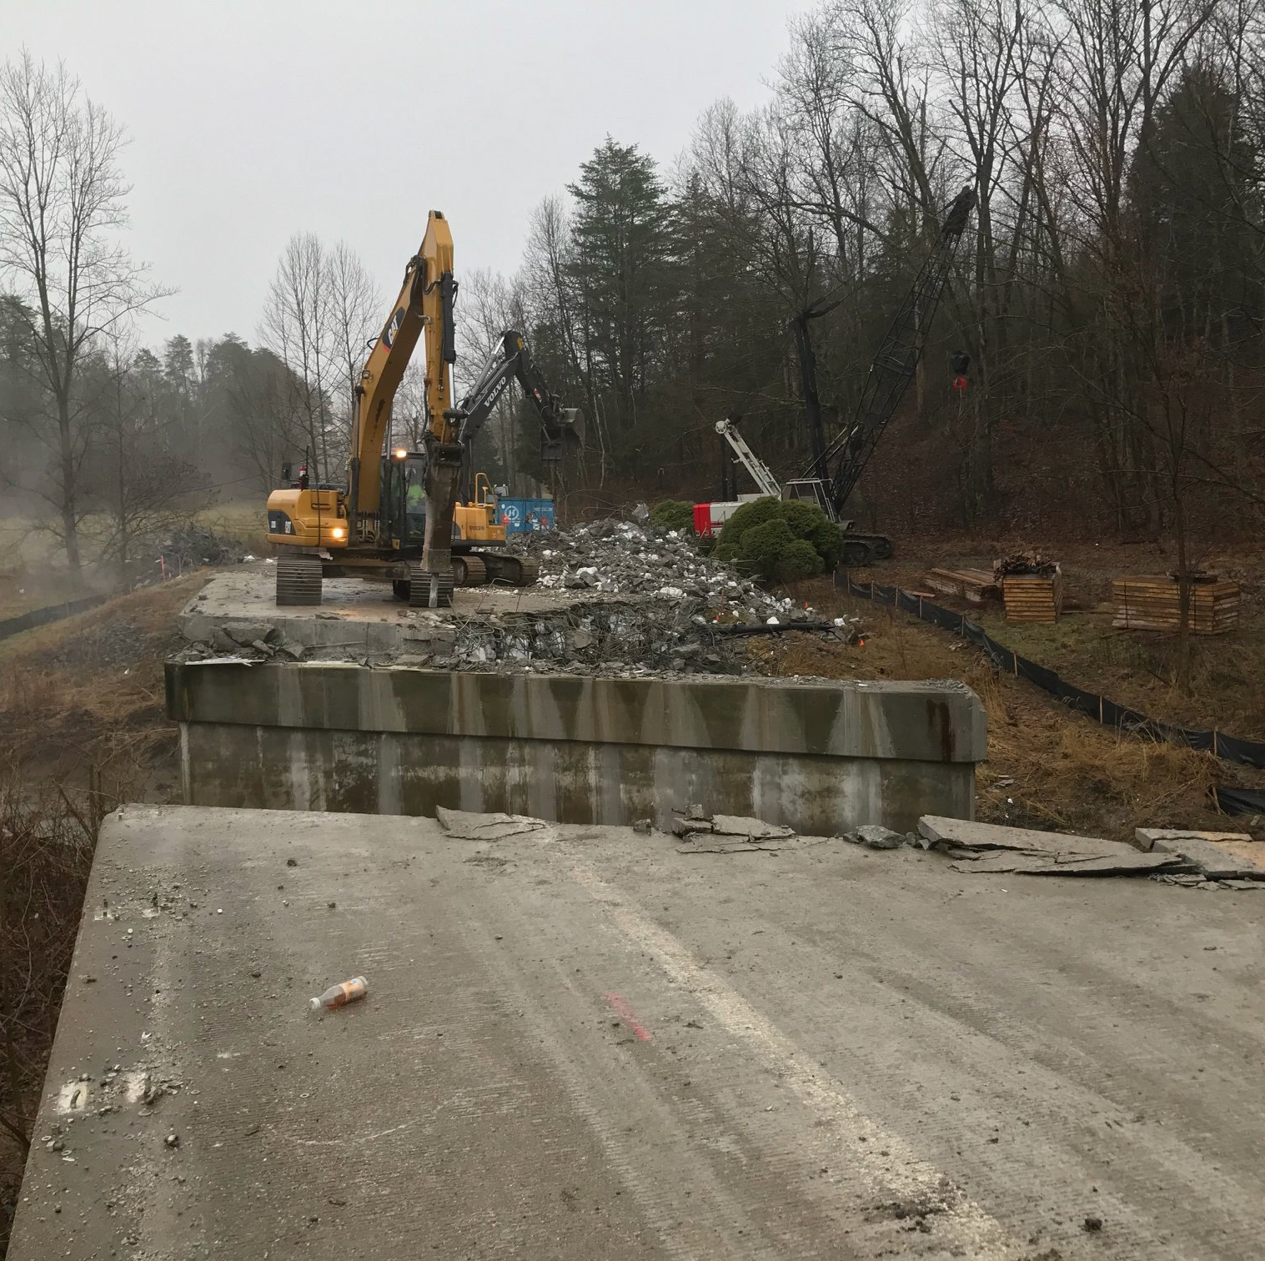
Stakeholder Engagement
Outreach and Listening Tour
Statewide Advisory Group
Student Engagement – Classroom visits, Tours, Lunch and Learns
Shared Best Practices

Slide 11
Stakeholders
Note, this is not a comprehensive list, but organizations that offered verbal and written support of efforts

Slide 12
BY Roads Construction Program
Fund training for up to 30 students
Provide supportive service funding to eliminate barriers to completion
Increase highway workforce diversity
Partner with industry and community to plan and build Indiana’s infrastructure
Support unemployed and underemployed Hoosiers in highway construction skills attainment and employment
Class Start – June to September

Slide 13
Heavy Highway Curriculum
10 – week training
NCCER – Core Curriculum
Heavy Highway
Orientation to the Trade
Highway Construction Safety/Work Zone Safety
Heavy Equipment Identification
ATSSA Certified Flagger Certification
Additional Training
CPR/First Aid
Employment Readiness Training
Financial Planning

Slide 14
Horizontal Classroom Visits
Highway Contractor
Introduction to participating contractors
What we do
Website and structure for each
Obtaining bid
Differing job sites
Contractor – Labor, Operator – information on unions, apprenticeships, training hours needed
Day in the life
INDOT
Introduction to Highway Work & INDOT
What we do
Agency structure
Processes design to bid to build
Types of projects
Career Pathways
INDOT – Maintenance, Mechanic, Construction
Day in the life

Slide 15
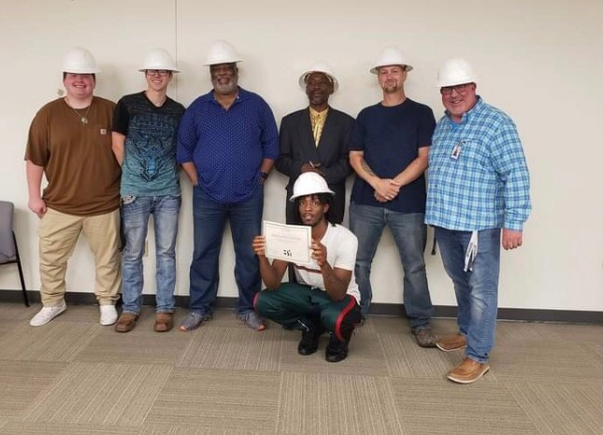
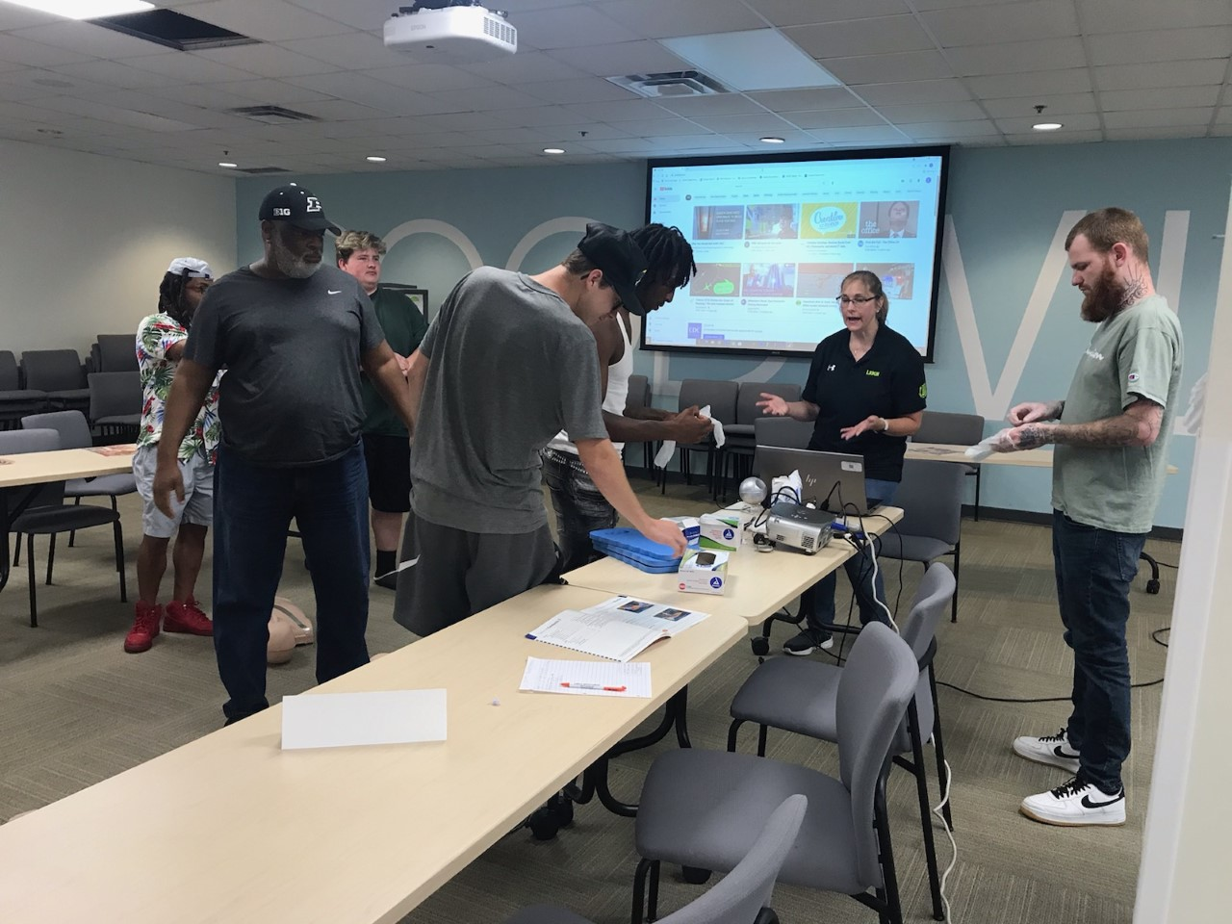
BY Roads
Top left, classroom visit from Unit Supervisor, Bottom left CPR training, Above, graduation

Slide 16
Lessons Learned
Recruitment
Location
32 Applicants
10 Enrolled
6 Complete

Slide 17
Lessons Learned
Content/Instruction
NCCER Core/Modules from Heavy Highway
Finding an instructor
Length of class - 10 Week Training

Slide 18
Lessons Learned
Employer Engagement
Industry Partners
Classroom Visits/Hiring
Work and Learn

Slide 19
Lessons Learned
Student Barriers
Transportation
Criminal Backgrounds/Fines
Housing

Slide 20
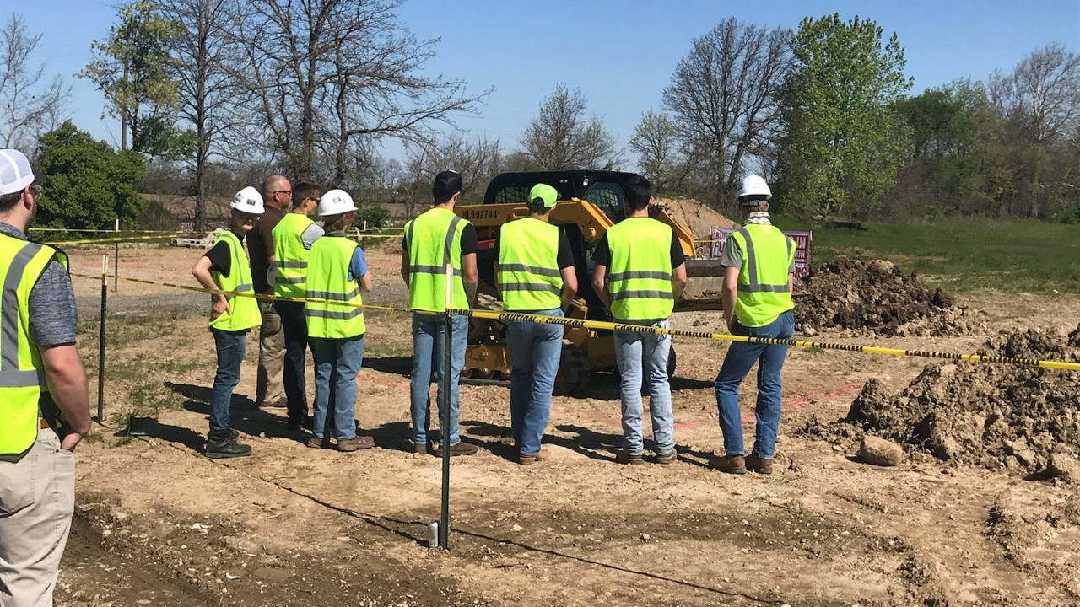
K12 – Horizontal Pathway
Hamilton Heights High School
Garrett High School
Lapel High School
New Palestine
Penn High School

Slide 21
Hamilton Heights SEAL

Slide 22
Summer Training 2021
Train the trainer, June 2021
Participating High Schools
Hamilton Heights
Garrett High School
Lapel
New Palestine
Pendleton Heights
Penn High School
Curriculum
Horizontal Construction – NCCER
Safety – OSHA Training
ATTSA Flagging
Storm Water Management
Inspection – Construction Earthworks
Skid Steer
Mini- Excavator

Slide 23
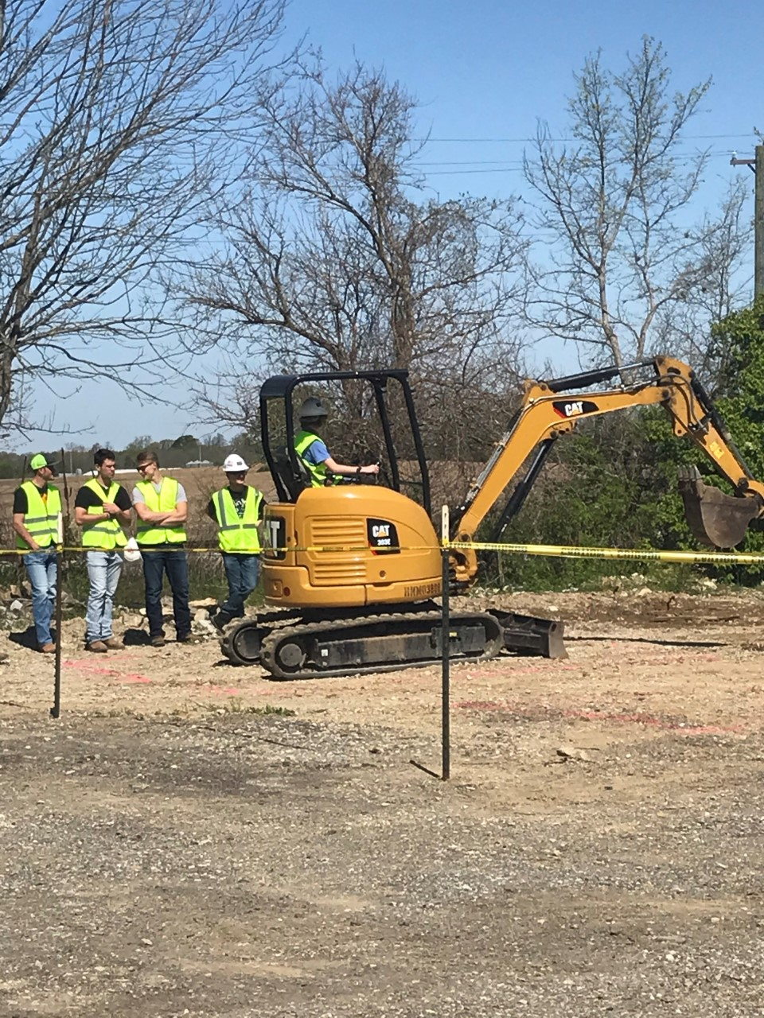
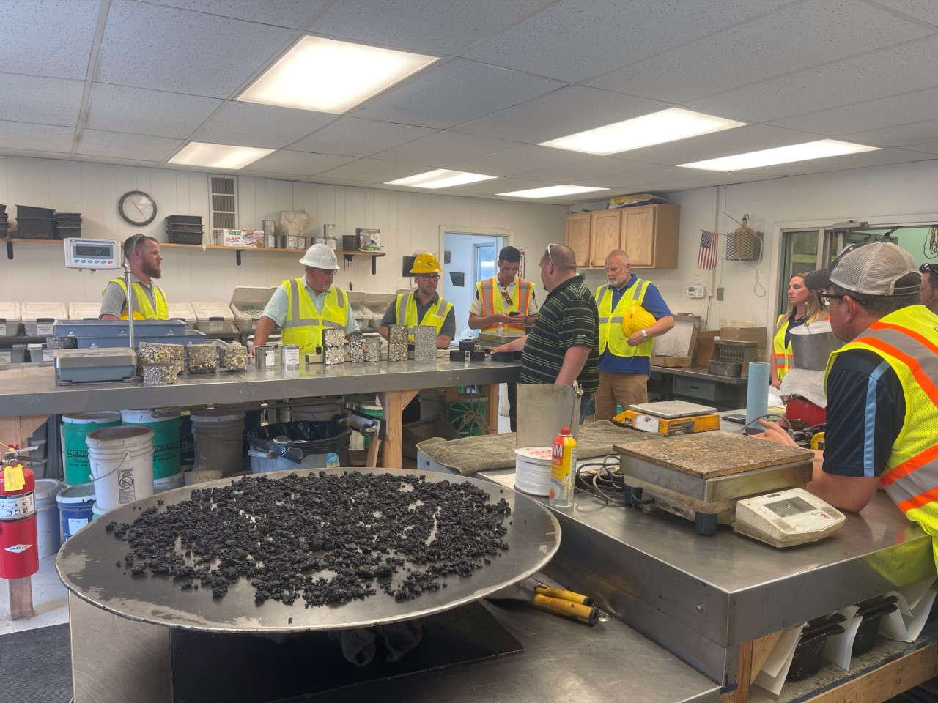
Hamilton Heights High School
Far top left, site tour, Bottom left train the trainer, Left, HH Sandbox

Slide 24
Moving Forward with INDOT
Moving Forward is an Indiana Department of Transportation employment program to build talent pipelines for Highway Technicians by partnering with community non-profits and state agencies that support justice involved citizens as they transition back into the workforce.

Slide 25
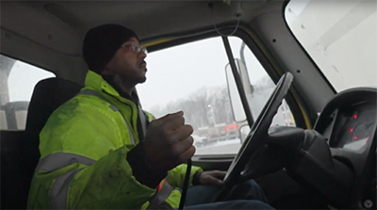
Results to Date
20 total referrals within 2 years
7 unique referring partners
16 interviews
10 job offers
8 hires total
1 Promoted to Unit Supervisor
1 Promoted to Crew Lead
4 Retained
Jay King, Unit Supervisor
“It’s quite beautiful to see so many different people serving the public. Putting all differences aside, we find our common ground and work toward the greater good of the people. That is what I love about INDOT.” (from State of Indiana Torch article)

Slide 26
Final Thoughts
Community Partnerships
Non-profits, Veterans, Re-entry, K12
Ask who else needs to have a seat at the table
Familiarize yourself what students are learning in the classroom
Ingratiate your training
Work-based Learning

Slide 27
Thank you!
Contact Info:
Chris Price, President
Indiana Construction Roundtable Foundation
Email: cprice@indianaconstruction.org
Phone: 317/805-1037
David Dalton, Workforce Development Director
Indiana Department of Transportation
Email: ddalton@indot.in.gov
Phone: 317/670-7935

